Slide 1
Writing Effective Newspaper Articles
Formula for Success
Copyright © 2012 Gareth Manning

Slide 2
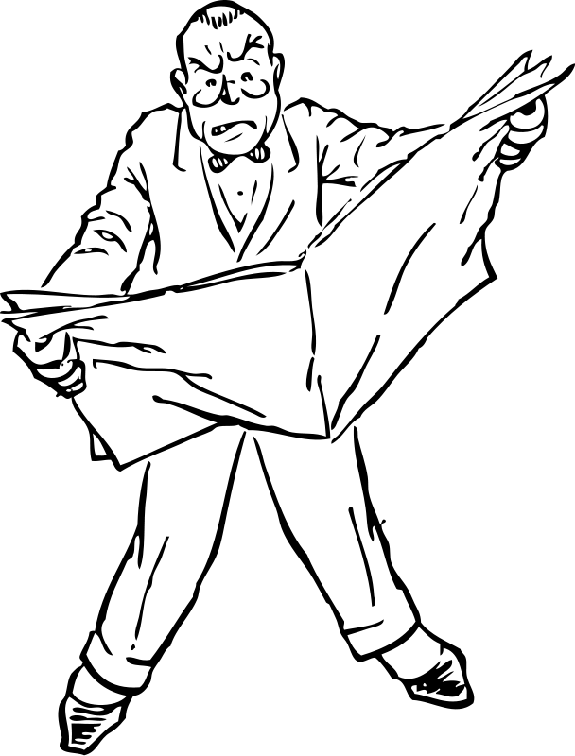
Inverted Pyramid Structure
Remember: most news readers skim quickly!
Most important info must be at the start!

Slide 3
A typical newspaper article contains six parts:
Headline: catches reader’s attention
Byline: tells who wrote the story, as well as the date.
Lead paragraph: Contains ALL of the who, what, when, where, why and how in it.
Example: This afternoon handsome school teacher, Gareth Manning, is being thrown a party for being wonderful by his Grade 9 students on Mount Robson using funds raised for their graduation ceremony.
Explanation paragraphs: Important facts and quotes not included in lead paragraph, written in order of importance (most to least).
Additional Information: Least important information, perhaps about a similar or related event.
Concluding Paragraph: Catchy, memorable ending.

Slide 4
Also…
Paragraphs must be short and concise.
Written in the third person.
Be unbiased—just a report on the facts.

